Slide 1
Bush River 115kV Crossing Rebuild
Tiffany Matthews-Lay
Project Management

Slide 2
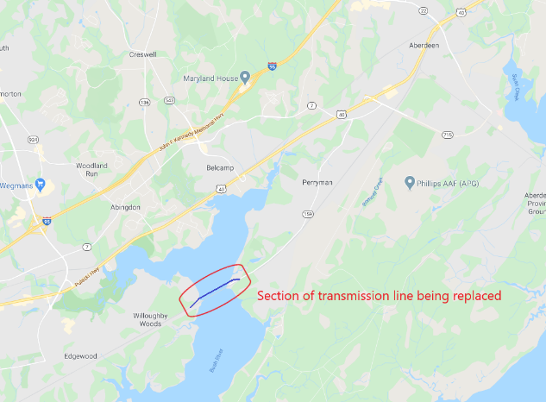
Proposed Bush River Project
Rebuild the Bush River Crossing
Remove 7 existing “lattice” structures
Install 9 new mono-pole structures and foundations
One structure located in Bush River
New conductor
1.3 miles long
Additional easements required
Construction starts September 2021
In-Service Date: May 2022
Bush River Crossing

Slide 3
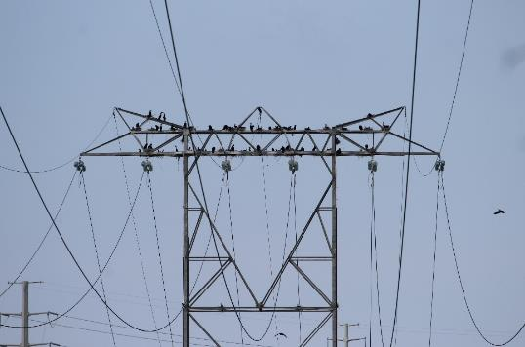
Project Necessity
BGE has the responsibility to maintain safety and the reliability of its electric system, achieved through routine inspection and maintenance of its existing transmission lines.
Inspections identified the transmission line at the Bush River Crossing (Circuits 110620/110621) as a priority transmission circuit in the BGE system.
Inspections identified seven (7) existing structures that require replacement.
Improve reliability and safety of the transmission line for communities and critical infrastructure.
This line connects three substations, one of which serves 12,500 customers and one serves APG critical infrastructure directly.
The existing transmission line consists of two circuits constructed in 1951 and has experienced substantial reliability and risk issues.
Severe avian contamination
Severe foundation degradation was discovered after an inspection in 1991
Mariner safety

Slide 4
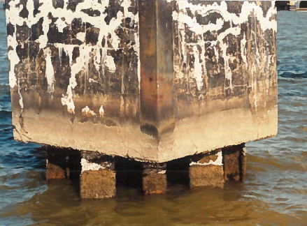
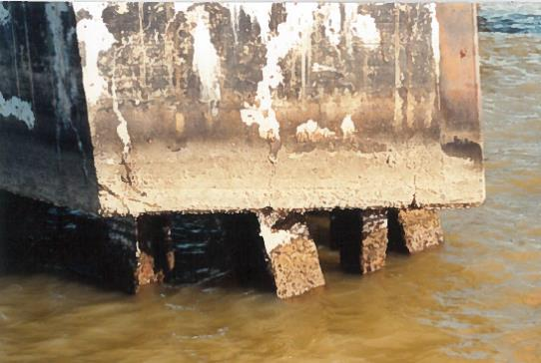
Structural Reliability and Safety
In 1991, these tower foundations were inspected, and severe degradation was discovered.
Although repairs were made in 1991, those repairs are now in year 30 of an expected 25-year life span.

Slide 5
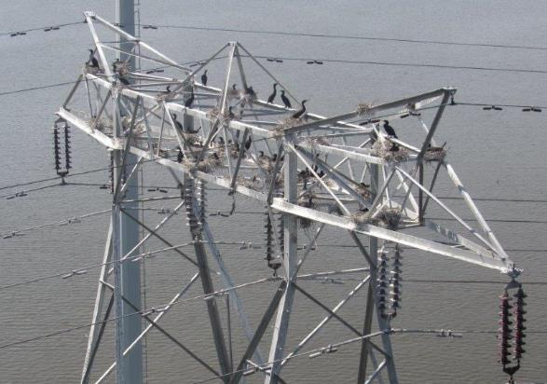
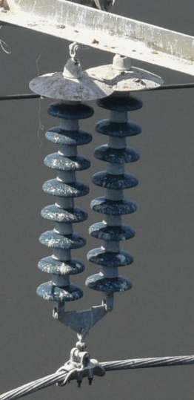
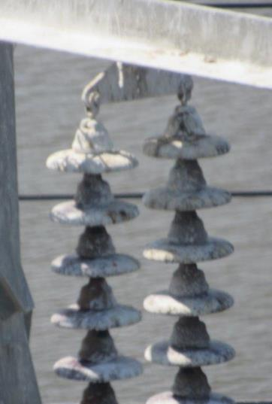
Avian Challenges
9 outages (2009-2019) were line-initiated, all 9 occurred within the Bush River Crossing
8 outages were related to avian interference
7 outages involved bird nest debris
1 outage involved bird droppings
1 unknown outage
Momentary outage on 5/10/2017 led to the discovery of a large colony of cormorants
Numerous nests
Significant contamination found on the insulators, conductors, tower steel, and foundations
According to the USDA-APHIS, there are no totally effective ways to keep the cormorants from inhabiting the tower

Slide 6
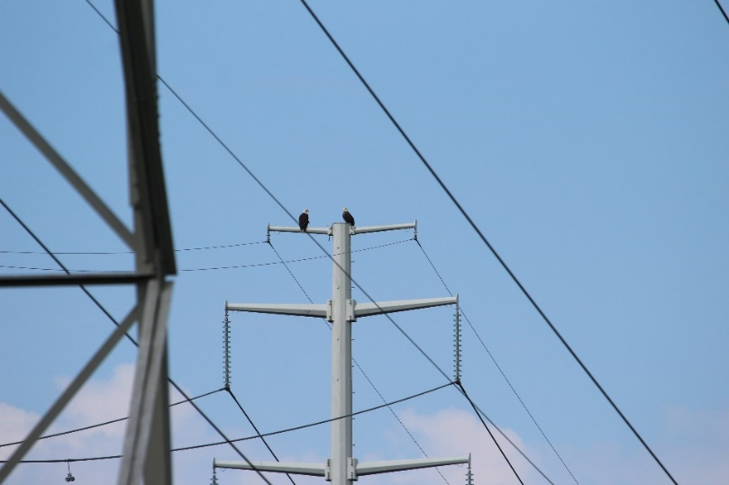
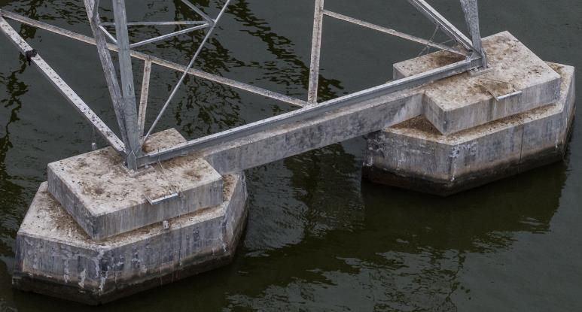
Avian Challenges (cont.)
During the inspection, an active osprey nest was also found on tower 56 (Perryman side).
Insulators were replaced and “guano shields” were installed, but due to the liquid state of the contaminant and the steady wind, the shields were not entirely effective.
Coexisting with cormorants means accessing a severely “contaminated” tower, maneuvering around mildly aggressive birds, and maintaining insulators and conductors that will continue to become contaminated.

Slide 7
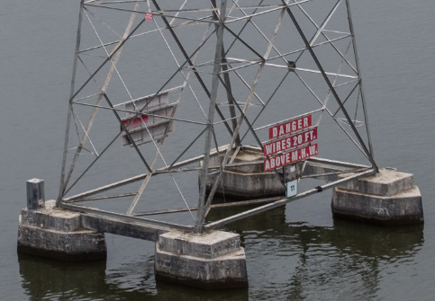
Boat Safety
The existing line has a low clearance over the Bush River.
The line has had a history of sailboat contacts, the most recent of which was in August 2000.

Slide 8
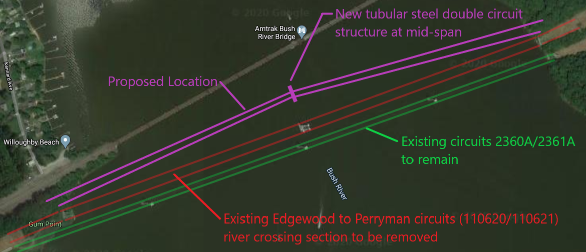
Proposed Solution
N
Removal
Three double circuit steel lattice towers (one on each shore and one located within Bush River)
Four single circuit wood H-frames (two on each side of the river)
Existing conductor (4 spans total)
Install
4 new single circuit structures at each bank
1 double circuit structure at mid-span in Bush River on pile foundation
New section will be built parallel to the existing line to minimize outage impacts
Design clearance of 49.1 ft (40 ft safe vessel height)

Slide 9
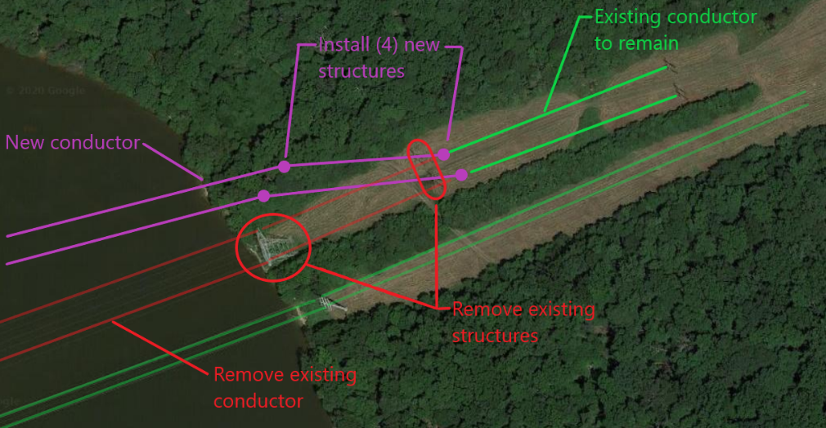
Proposed Solution – Each Bank
Removal
Three double circuit steel lattice towers (one on each shore and one located within Bush River)
Four single circuit wood H-frames (two on each side of the river)
Existing conductor (4 spans total)
Install
4 new single circuit structures at each bank
New conductor (4 spans)
Caisson foundations on land
Pole caps will be used to deter birds from nesting on structures

Slide 10
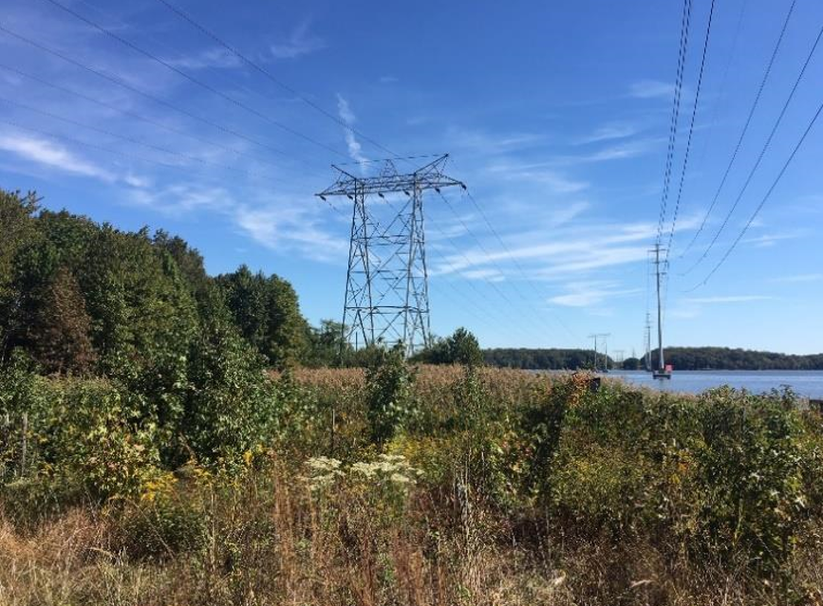
Environmental Mitigation
BGE is developing mitigation plans with Harford County and the Maryland Department of Environment and Department of Natural Resources to address:
Restoring areas where existing structures are removed
Planting new trees
Restoring the Critical Area Buffer
Requiring contractor to use Best Management Practices during construction activities
Ensuring the construction schedule takes the wildlife impact into consideration

Slide 11
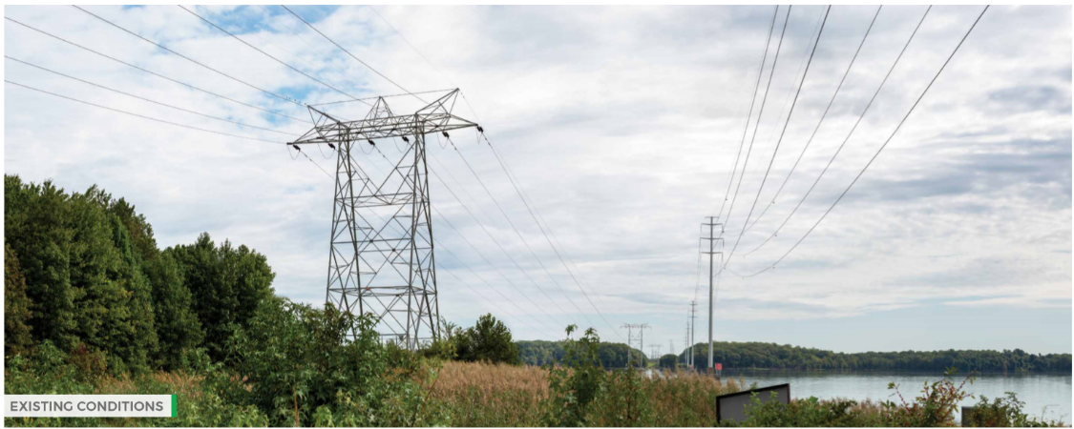
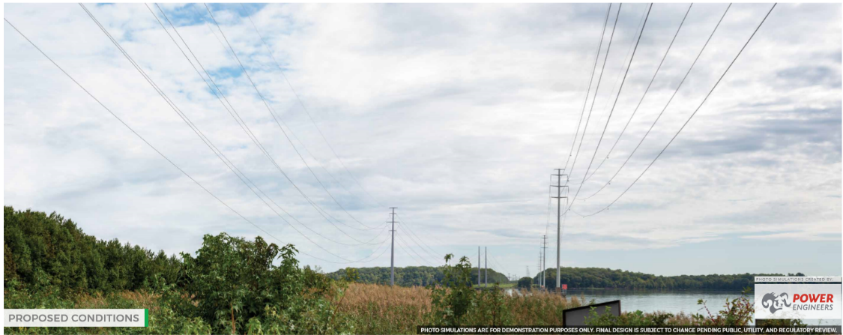
Renderings

Slide 12
Project Website
https://www.bge-tsrep.com/projects/bush-river-crossing/

